Slide 1
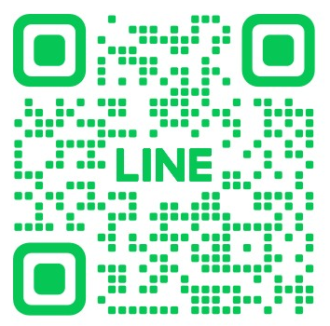
Rundown
9:40 | 10:10 | Registration / Polaroid Shooting
10:10 | 10:40 | Introduction of IMPIS Faculty IMPIS Director Mentors Student Self-Introduction Group Photo
10:40 | 11:20 | Introduction of IMPIS Office IMPIS Regulations
11:20 | 11:40 | Interaction Time
11:40 | 12:00 | Prize Quiz
12:00 | | Lunch
Join our group chat if you haven’t!

Slide 2



ORIENTATION
IMPIS, CIA, NCCU
2023. NOV. 11th

Slide 3

Schedule
10:00 | 10:40 | Introduction of IMPIS Faculty IMPIS Director IMPIS Mentors Student Self-Introduction Group Photo
10:40 | 11:20 | Introduction of IMPIS Office IMPIS Regulations
11:20 | 11:40 | Interaction Time
11:40 | 12:00 | Prize Quiz
12:00 | | Lunch

Slide 4
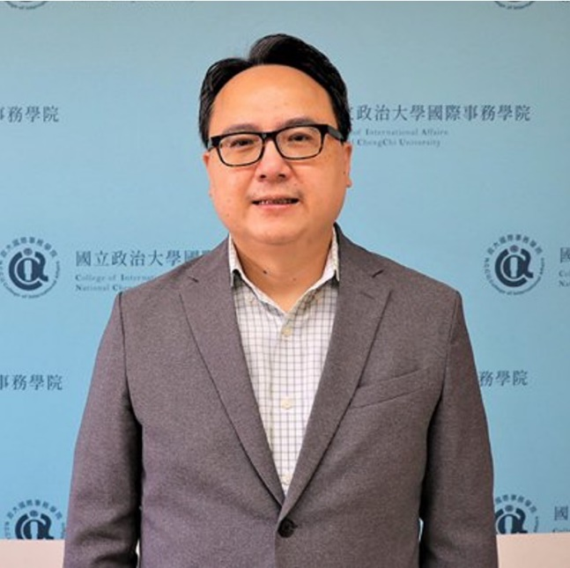
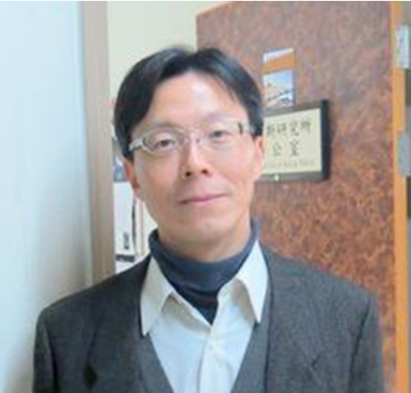
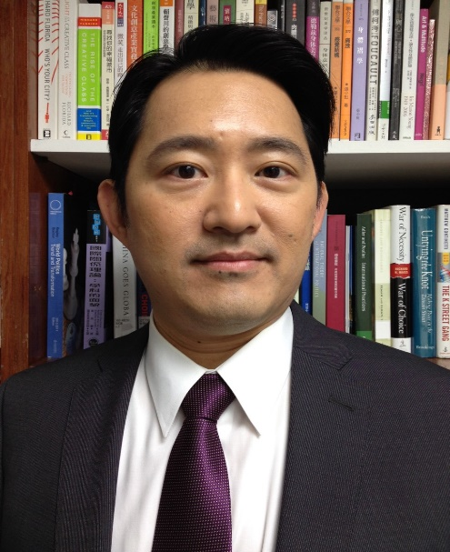
About CIA
College of International Affairs (CIA)
11F of General Building North Wing
DEAN
VICE DEAN
Prof. LIEN, Hong-Yi
Prof. WEI, Bai-Ku
Prof. Lu, Yeh-Chung

Slide 5



About IMPIS
International Master’s Program in International Studies (IMPIS)
11F of General Building North Wing
Director
Professors of Required Courses
Prof. Lee, Chia-Yi
Prof. Huang, Chiung-Chiu
Prof. Lee, Chia-Yi
Mentor
Prof. Fabricio Fonseca
Prof. Lee, Chia-Yi
Prof. Su, Cho-Hsin

Slide 6


IMPIS ASSISTANT
Maxim
IMPIS HELPERS
Hermann Jerry Tina
IMPIS Office

Slide 7

Self-Introduction
Let us know more about you!
What’s your name?
Where are you from?
What’s your interest?
Any other thing you would like us to know?
Notes:
可多major, study interest
準備移動麥克風組

Slide 8
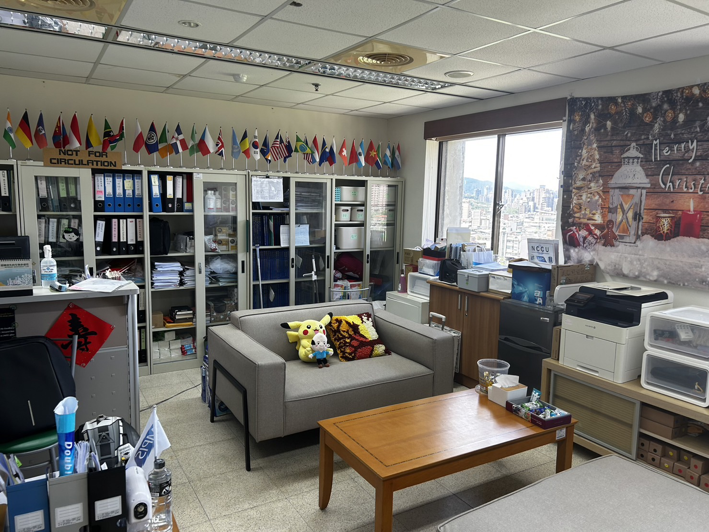
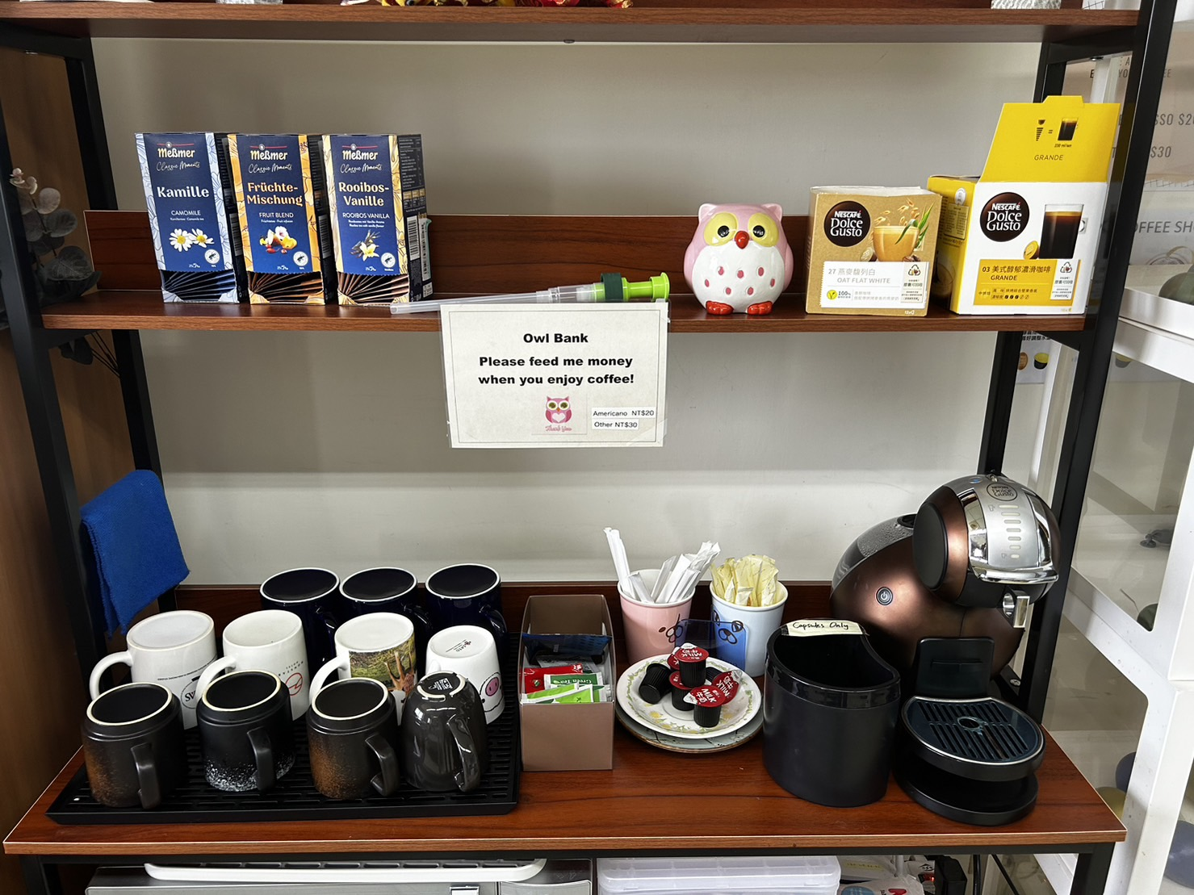
In the Office
Lounge Area
Coffee & Tea
Mon-Fri
09:00-12:00
13:30-17:00
Office Hour
Tea bag
Coffee (NTD20 - 30)
Encourage to bring your own cup. Let’s treat our globe well
Avoid days around holidays
→ Some people will have day-off (i.e. might not get the answer right away

Slide 9
WE OFFER
Printing & Scanning
Documents only
1 NTD per page
Documents
Enrollment certificate
Recommendation Letter for work permit
Proof of expected graduation, etc

Slide 10
Be Aware of…
Scam
Email / phone call / social media / dating app etc.
ATM only has transfer & withdrawal functions
Do not lend your account(s) to anyone
Driving/Riding vehicle(s)
Need to have license(s)
No drunk driving/riding
No hit-and-run if the traffic accident happens
Sexual Harassment
Either verbal or physical is prohibited
Offender: 2 years in prison, 1-120 days of detention, NTD 100,000 fine
Victim: call the police, Gender Committee (campus)

Slide 11
Support
IMPIS Office
11F of General Building North Wing
Courses, thesis procedure, graduation check, ICDF, etc
Office of International Cooperation (OIC)
8F of Administration Building
Things related to non-Taiwanese issues, e.g. ARC, NHI, MOE, MOFA
Physical & Mental Health Center
The building beside the post office
Counseling Services, emergency aids, etc

Slide 12
About the enrollment
8 semesters
4 semesters
STUDY
SUSPENSION
2 kinds of fee to pay each semester:
Enrollment
Credit fee: there is late penalty* Oct. 23rd – Nov 24th, 2023
If you are holding an ARC,
you could not extend the ARC with the study purpose during the suspension period.
For more details, please check with OIC
Penalty fee (started from Fall 2022):
Increase 1% of total fee every 2 days
Maximum: 15% of total fee & less than NT$2,000

Slide 13
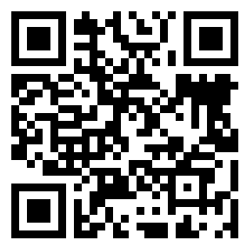
Program Requirement
NO maximum or minimum number of credits for each semester.
30 Credits
MA Thesis
9 required
+ 21 elective
2 defenses with a gap of at least 4 months
Only 9 credits from NON-IMPIS courses could be counted. For the rest, please take IMPIS courses.
Proposal & Final
How to start the thesis?
https://shorturl.at/lsBC3
Definition: courses from College of International Affairs
Course Search System
https://qrysub.nccu.edu.tw/#

Slide 14
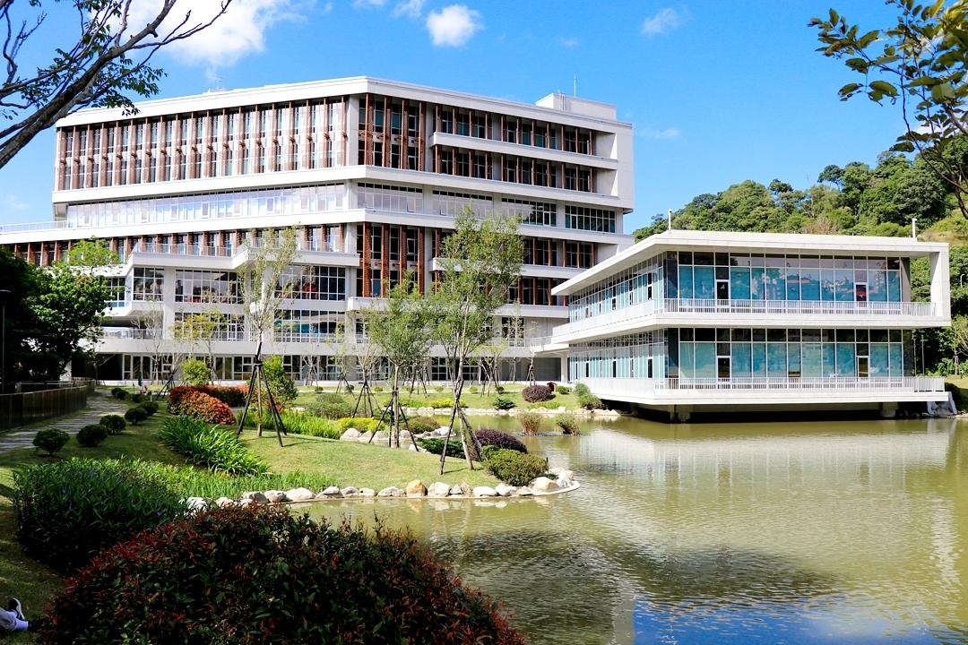

Resources
Libraries
5 libraries!
Books, journals, e-resources, etc.
Reservation of space(s)
Proposal & Thesis from IMPIS
Many proposal and thesis copies of IMPIS alumni in the office. You could read/borrow proposal/thesis from the office.
Borrow: 1 proposal & 2 thesis max
Time: return by the end of semester, could extend once.

Slide 15
Suggested Schedule (2 years)
1
2
3
4
Exploring thesis topic
and asking for an advisor
Taking 30 credits
Writing proposal
X
Proposal Defense
Finishing the thesis
Final Defense
X

Slide 16
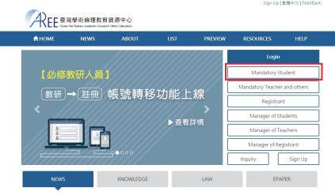
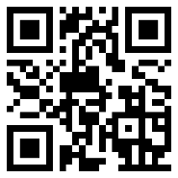
Research Ethics Education Course
Take the class & pass the exam online
Suggest to complete in your 1st year academic year
Approx. 4 hours + online tests.
Login in at website: https://ethics.nctu.edu.tw/
Account: student ID Password: the last 5 digits of student ID

Slide 17
Golden Rules for defenses
1.
Have final defense four months after passing proposal defense
2.
Apply for defenses 2 weeks prior to the date
3.
Submit one copy of proposal/thesis for public exhibition 2 weeks prior to the date

Slide 18
Step one: Start
Topic & Advisor
You may find some domains that you are interested in or get some idea from the courses you have taken
You could have a talk with professors doing relevant researches
You may ask them politely if they could be your advisor, or if they have some professors recommended
Normally, students find NCCU professors as their advisors, but it is not a must

Slide 19
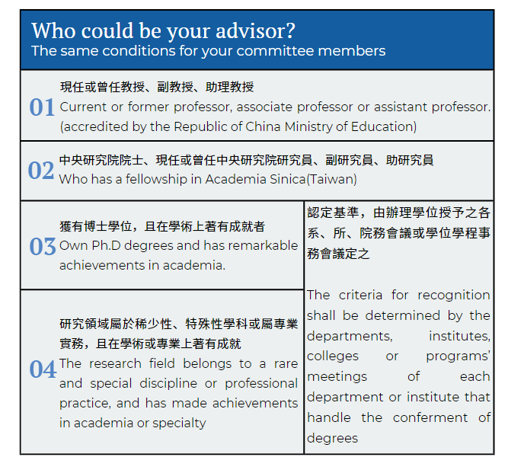
Step one: Start
Topic & Advisor

Slide 20
Step two: Proposal
Prepare documents
Declaration Form of Thesis Topic & Advisor
Application Form for Proposal Defense (IMPIS Form)
A hardcopy of your proposal (with signature of advisor(s))
Committee Members (3-5)
Qualification: same as advisor
1/3 should be affiliated with another institution (external)
Part-time prof: internal & external Retired prof: external
Discuss with your advisors

Slide 21
Step two: Proposal
Reserve a conference room
Discuss the date & time of the proposal with your advisor & committee members
Check with IMPIS office if there is room available
Yes → confirm; No → go back to point 1
Submit documents to IMPIS office
2 weeks before the date of your proposal defense
Provide your proposal to committee members
Send your proposal via mail/email (depends on their preferences)

Slide 22
Step three: Final
Check your qualifications
Be enrolled/registered in the semester
Already declared your advisor and thesis topic (Did at proposal defense)
Finish the requirement of graduation including credits
Finish the Course of Academic Ethics and Research Integrity
Complete the thesis and upload it to Turnitin for plagiarism.

Slide 23
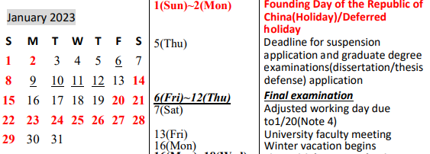
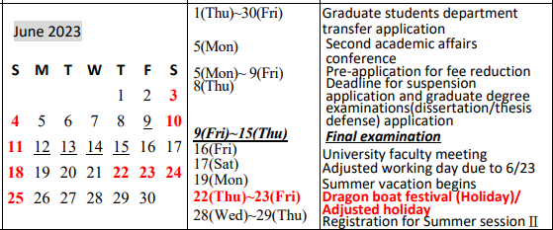
Step three: Final
Application of having Degree Exam
Regulated by NCCU
Deadline: Fall 2022: Jan 5, 2023 Spring 2023: June 8, 2023
IMPIS DDL would be 1 week earlier for the administrative time
Q: Do I have to finish my thesis before DDL?
A: You could still write your thesis. But you would need to finish around 80% for turnitin and show advisor that you are able to have the final defense by the end of semester.
Prepare documents
Application form to have the degree examination
Percentage page of Turnitin with advisor’s signature

Slide 24
Step three: Final
Reserve a conference room
Discuss the date & time of the final defense with your advisor & committee members
Check with IMPIS office if there is room available
Yes → confirm; No → go back to step 1

Slide 25
Step three: Final
Submit documents to IMPIS Office
2 weeks before the date of your final defense
Prepare documents
Application Form for Final Defense (IMPIS Form)
A hardcopy of your thesis (with signature of advisor(s)) (IMPIS)
Provide your thesis to committee members
Send your thesis via mail/email (depends on their preferences)

Slide 26
Step three: Final
Submit test score
After you pass your final defense, we would need to have director’s signature on the score sheet and submit it to the registration office before Jan 31st/July 31st
Avoid arrange everything in the last day
You could start school leaving process after 3 days submission of test score.

Slide 27
Additional Info
Can I have my defenses online?
According to the NCCU regulations, defenses have to be physical principally.
Is there any requirement for the length, pages, references for thesis?
IMPIS only have one requirement to the thesis: related to International Studies. For others, we all respect the advices from your advisor.
Should I find advisor among professors of our college?
You could find anyone who meets the conditions on p.7.

Slide 28
Additional Info
Can I take Doctor degree courses?
Yes, as long as the lecturer and department agree, you can have doctoral courses and they will be counted as graduation credits.

Slide 29
Last reminders
Check your NCCU mailbox regularly
University mainly send important email to this mailbox.
IMPIS will send emails to your NCCU mailbox since today.
If you want to receive them with your personal mailbox, you may use the ”forward” function.
IMPIS Website
We will share some speeches, workshops, scholarship, intern, etc. if we receive the information.
https://impis.nccu.edu.tw/eng/PageFront?fid=10704

Slide 30

END
QA SESSION
THANK YOU!
impis@nccu.edu.tw
https://impis.nccu.edu.tw/

